Slide 1

New Triathlon Insurance Product – Technical Solution
Presentation for the Business Stakeholders
Álvaro Puertas Puñal
Solution Architect
20 August 2024

Slide 2

The new Triathlon Insurance product is designed specifically to meet the needs of triathletes, providing comprehensive coverage that traditional insurance policies do not offer.
Current insurance products often fail to cover the unique risks associated with triathlons, such as equipment damage during the competition.
Notes:
Slide 2: Presentation Objective
Brief summary of the purpose of the presentation: to explain the technical solution developed and how this proposal can positively impact the business.
Highlight that the focus will be on creating a new, specialized insurance product for triathlons.

Slide 3
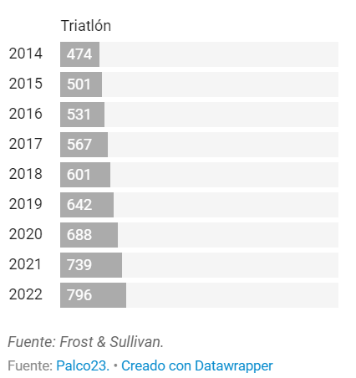
Regarding triathlons, they do not attract as many athletes as pure runners, but the target audience has a high purchasing power. According to USA Triathlon (USAT), these athletes spend more than average: 80% of Americans who chose this discipline had a college education and a household income of 130,000 euros per year, which allows them to invest 2,100 euros annually in nutrition and sports equipment, and 990 euros in training.
The evolution of the business in millions of euro
Notes:
Slide 2: Presentation Objective
Brief summary of the purpose of the presentation: to explain the technical solution developed and how this proposal can positively impact the business.
Highlight that the focus will be on creating a new, specialized insurance product for triathlons.

Slide 4
Customer Benefits:
This product specifically benefits the triathlete, making their experience safer and more secure.
Comprehensive Coverage: Covers equipment, injuries, and unforeseen events like cancellations or delays.
Peace of Mind: Allows athletes to focus on competing, knowing they are fully protected.
Tailored Protection: Policies can be customized based on the athlete's level (amateur vs. professional) and the type of triathlon (sprint, ironman, etc.).
Notes:
Slide 2: Presentation Objective
Brief summary of the purpose of the presentation: to explain the technical solution developed and how this proposal can positively impact the business.
Highlight that the focus will be on creating a new, specialized insurance product for triathlons.

Slide 5
Business Benefits:
This product will create a new revenue stream for Zurich and helps differentiate the brand in a competitive market.
Market Differentiation: Zurich becomes the go-to insurer for triathletes, enhancing brand loyalty and attracting a new customer segment.
Revenue Growth: Capture a growing market with specific needs, leading to increased policy sales.
Cross-Selling Opportunities: Potential to offer other Zurich products to triathletes, such as travel insurance or personal accident insurance.
Notes:
Slide 2: Presentation Objective
Brief summary of the purpose of the presentation: to explain the technical solution developed and how this proposal can positively impact the business.
Highlight that the focus will be on creating a new, specialized insurance product for triathlons.

Slide 6
Product features:
Provide a more granular look at what the product covers, including specific features like:
Equipment Coverage: Covers bikes, wetsuits, helmet and other gear used in triathlons.
Event Coverage: Covers entry fees, travel expenses, and accommodation costs if the event is canceled or postponed.
International Coverage: Ensures coverage for athletes competing in events worldwide.
Notes:
Slide 2: Presentation Objective
Brief summary of the purpose of the presentation: to explain the technical solution developed and how this proposal can positively impact the business.
Highlight that the focus will be on creating a new, specialized insurance product for triathlons.

Slide 7
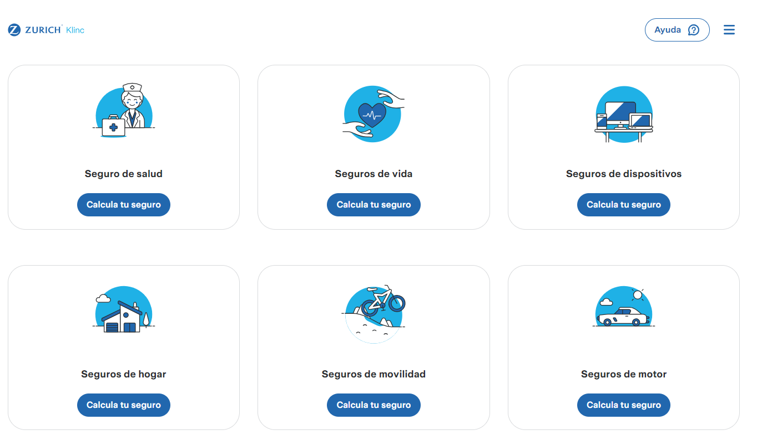
As a part of klinc.com, we can add the new product quickly to the market.

Slide 8
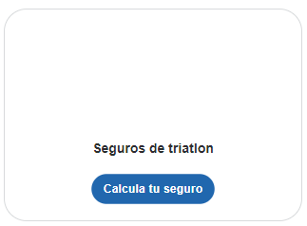
As a part of klinc.com, we can add the new product quickly to the market.

Slide 9
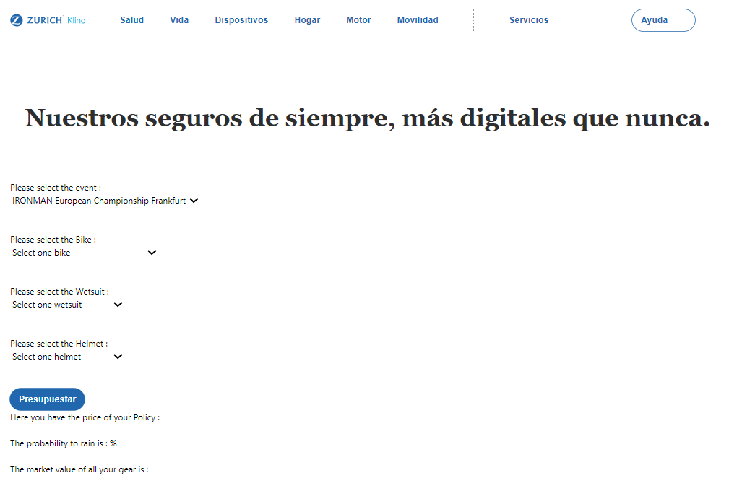

Slide 10

← Step 1 : Select the event

Slide 11
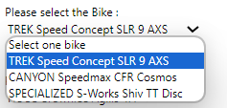
← Step 2 : Select the bike (optional)

Slide 12
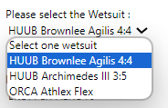
← Step 3 : Select the wetsuit (optional)

Slide 13
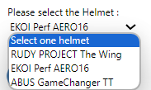
← Step 4 : Select the helmet (optional)

Slide 14
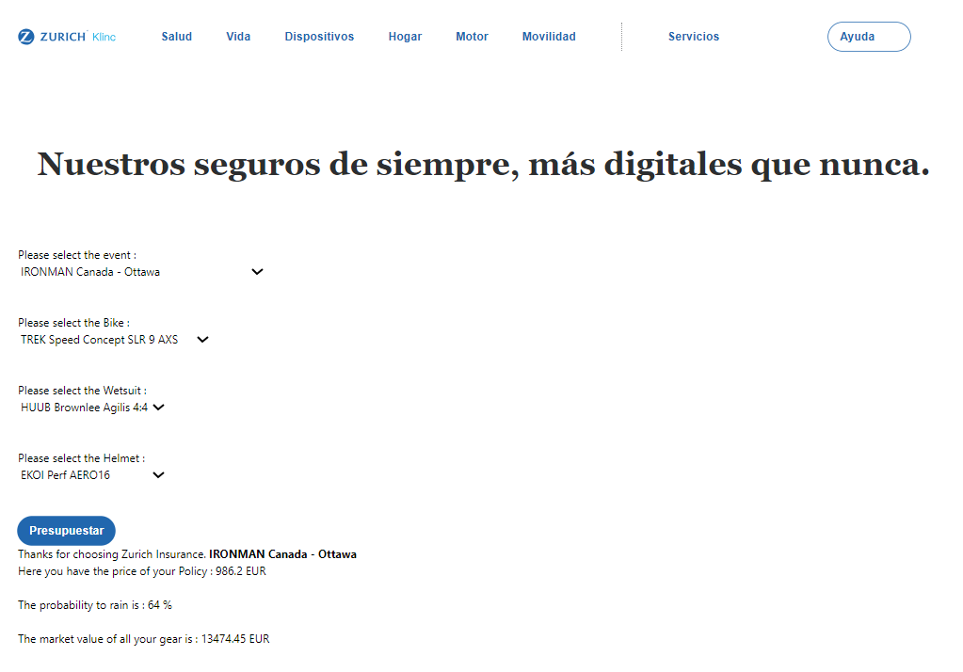
← Step 5 : get the quote

Slide 15
Result :
The information of the event
The price of the policy
Probability to rain during the competition
More probability to rain = more probability to have an accident riding the bike → increase the quote * 1.5
Sum of the market value of all the gear selected

Slide 16
Any Questions ?
Álvaro Puertas Puñal
Solution Architect
20 August 2024

